Slide 1
XAML Performance Developer’s Guide to Windows 10

Slide 2
Agenda
What is performance?
Progressive rendering
Deferred loading

Slide 3
What is performance?
Startup performance
XAML tree density and complexity
Rendering performance
Including memory consumption
Interactive performance
Including scrolling performance
Workflow performance
Including animations

Slide 4
Benefits on the universal platform
Memory
Startup

Slide 5
Windows 10 text renders 50% faster

Slide 6
Phase rendering

Slide 7
Without phases, every element is rendered at once

Slide 8
x:Phase & phase rendering
<DataTemplate x:DataType="model:Monster">
<Grid Width="200" Height="80">
<TextBlock Text="{x:Bind Name}" />
<TextBlock Text="{x:Bind StarSign}" x:Phase="1"/>
</Grid>
</DataTemplate>
Some guidance
Phase "0" is the default
Only a few, manageable phases
Phase numbers don't need to be contiguous

Slide 9
Deferred loading

Slide 10
Understanding deferral
Reduce the number of elements at startup
Declare the UIElement-derived items (or containers) you don't want rendered
Ways to realize an element
FindName()
GetTemplatedChild() (for ControlTemplate)
Storyboard & VisualStates (because of FindName)
Nothing is free
A lightweight proxy element is created
Events are hooked up after realized
Binding is completed after realized (including x:Bind)

Slide 11
x:Defer example
<StackPanel
x:Name="AdditionalProductPage"
Visibility="Collapsed"
x:DeferLoadStrategy="Lazy">
<!– your lovely XAML goes here-->
</StackPanel>

Slide 12
Demo: x:Defer

Slide 13
Visual states will realize deferred elements

Slide 14
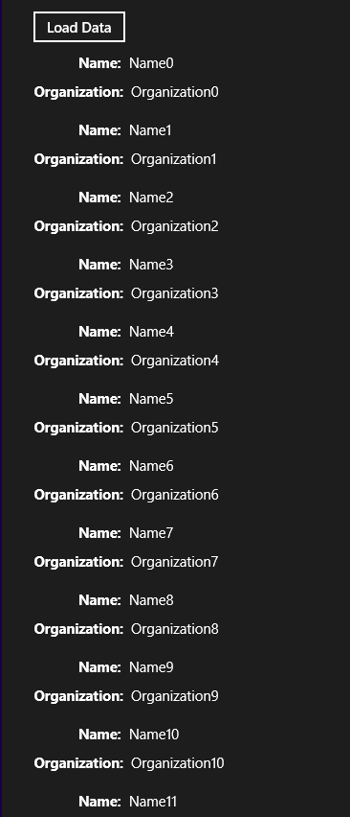
Three types of virtualization
Visual virtualization
The developer does not have to do anything
Data virtualization
Random access virtualization
Incremental virtualization

Slide 15
Review
What is performance?
Phase rendering
Deferred loading

